Slide 1
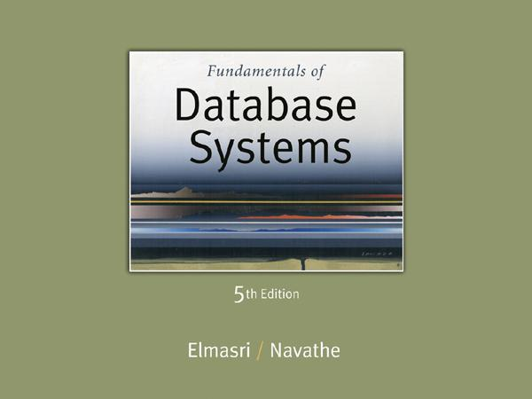
Slide 2- 1
Notes:
1

Slide 2
Chapter 2
Database System Concepts and Architecture
Copyright © 2007 Ramez Elmasri and Shamkant B. Navathe
Notes:
2

Slide 3
Outline
Data Models and Their Categories
History of Data Models
Schemas, Instances, and States
Three-Schema Architecture
Data Independence
DBMS Languages and Interfaces
Database System Utilities and Tools
Centralized and Client-Server Architectures
Classification of DBMSs
Slide 2- 3
Notes:
3

Slide 4
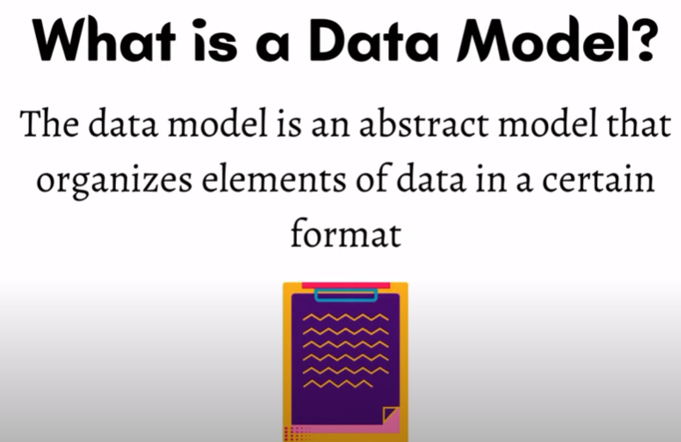
Data Models
Underlaying structure of a database
Data+Relationship+Semantics+Constraints

Slide 5
Data Models
Data Model:
A set of concepts to describe the structure of a database, the operations for manipulating these structures, and certain constraints that the database should obey.
Data Model Structure and Constraints:
Constructs are used to define the database structure
Constructs typically include elements (and their data types) as well as groups of elements (e.g. entity, record, table), and relationships among such groups
Constraints specify some restrictions on valid data; these constraints must be enforced at all times
Slide 2- 5
Notes:
5

Slide 6
Data Models (continued)
Data Model Operations:
These operations are used for specifying database retrievals and updates by referring to the constructs of the data model.
Operations on the data model may include basic model operations (e.g. generic insert, delete, update) and user-defined operations (e.g. compute_student_gpa, update_inventory)
Slide 2- 6
Notes:
6

Slide 7
Categories of Data Models
Conceptual (high-level, semantic) data models:
Provide concepts that are close to the way many users perceive data.
(Also called entity-based or object-based data models.)
Physical (low-level, internal) data models:
Provide concepts that describe details of how data is stored in the computer. These are usually specified in an ad-hoc manner through DBMS design and administration manuals
Implementation (representational) data models:
Provide concepts that fall between the above two, used by many commercial DBMS implementations (e.g. relational data models used in many commercial systems).
Slide 2- 7
Notes:
7

Slide 8
History of Data Models
Hierarchical Model
Network Model
Relational Model
Object-oriented Data Models
Object-Relational Models
Slide 2- 8
Notes:
8

Slide 9
History of Data Models
Hierarchical Data Model:
In this, the data is organized into a tree-like structure where each record consists of one parent record and many children.
single one-to-many relationship between two different kinds of data.
Initially implemented in a joint effort by IBM and North American Rockwell around 1965. Resulted in the IMS family of systems.
IBM’s IMS product had (and still has) a very large customer base worldwide
Slide 2- 9
Notes:
9

Slide 10
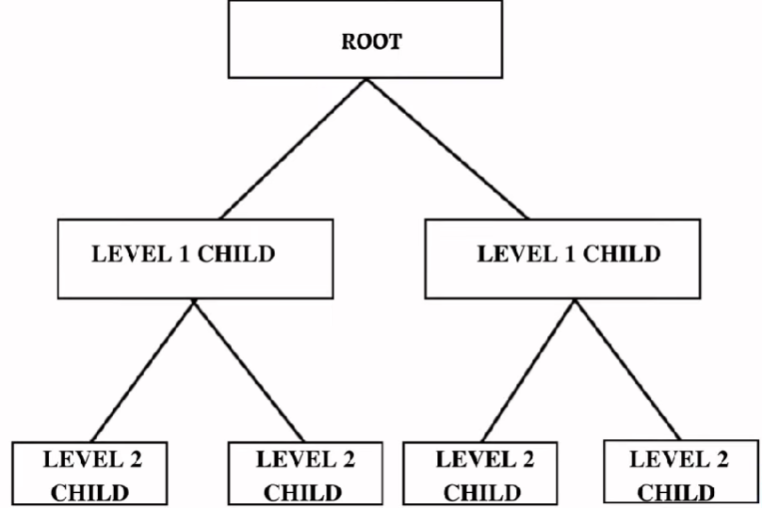
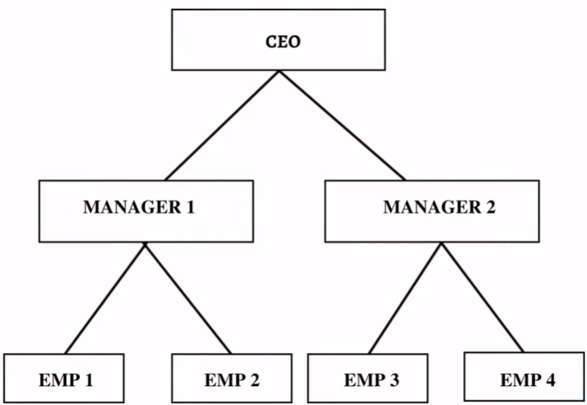
Example

Slide 11
Hierarchical Model
Advantages:
Simple to construct and operate
Corresponds to a number of natural hierarchically organized domains, e.g., organization (“org”) chart
Language is simple:
Uses constructs like GET, GET UNIQUE, GET NEXT, GET NEXT WITHIN PARENT, etc.
Disadvantages:
Navigational and procedural nature of processing
Database is visualized as a linear arrangement of records
Little scope for "query optimization"
Slide 2- 11
Notes:
11

Slide 12
History of Data Models
Network Model:
This database model enables many-to-many relationships among the connected nodes.
The data is arranged in a graph-like structure, and here ‘child’ nodes can have multiple ‘parent’ nodes.
The parent nodes are known as owners, and the child nodes are called members.
The first network DBMS was implemented by Honeywell in 1964-65 (IDS System).
Adopted heavily due to the support by CODASYL (Conference on Data Systems Languages) (CODASYL - DBTG report of 1971).
Slide 2- 12
Notes:
12

Slide 13
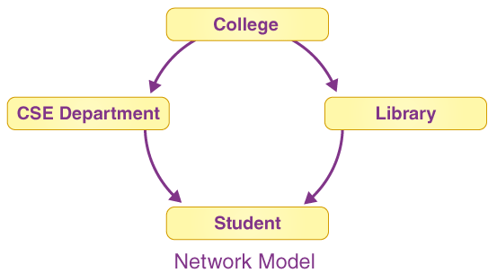
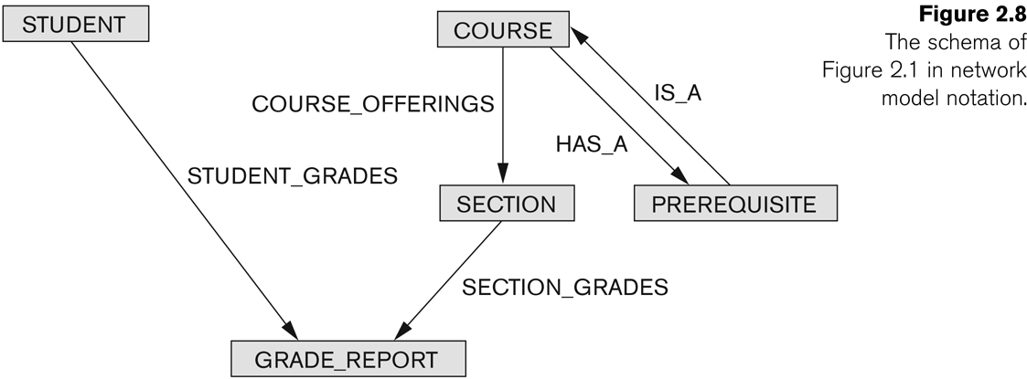
Example of Network Model Schema
Slide 2- 13

Slide 14
Network Model
Advantages:
Network Model is able to model complex relationships and represents semantics of add/delete on the relationships.
In comparison to the hierarchical model, data can be retrieved faster.
The data can be accessed in a variety of ways.
Language is navigational; uses constructs like FIND, FIND member, FIND owner, FIND NEXT within set, GET, etc.
Programmers can do optimal navigation through the database.
Slide 2- 14
Notes:
14

Slide 15
Network Model
Disadvantages:
As the number of relationships to be managed grows, the system may get increasingly complicated.
To operate with the model, a user must have a thorough understanding of it.
Any alteration, such as an update, deletion, or insertion, is extremely difficult.
Slide 2- 15
Notes:
15

Slide 16
ER Model
Entity Relationship Model
An ER model is the logical representation of data as objects and relationships among them.
These objects are known as entities, and relationship is an association among these entities.
This model was designed by Peter Chen and published in 1976 papers.
It was widely used in database designing.
A set of attributes describe the entities.

Slide 17
History of Data Models
Relational Model:
In this model, data is organized in two-dimensional tables and the relationship is maintained by storing a common field.
Proposed in 1970 by E.F. Codd (IBM), first commercial system in 1981-82.
Now in several commercial products (e.g. DB2, ORACLE, MS SQL Server, SYBASE, INFORMIX).
Several free open source implementations, e.g. MySQL, PostgreSQL
Currently most dominant for developing database applications.
SQL relational standards: SQL-89 (SQL1), SQL-92 (SQL2), SQL-99, SQL3, …
Slide 2- 17
Notes:
17

Slide 18
History of Data Models
Object-oriented Data Models:
Multiple objects are connected in this model using connections.
These models are specifically designed to integrate object-oriented programming paradigms with database management, enabling persistent storage of objects.
One set comprises models of persistent O-O Programming Languages such as C++ (e.g., in OBJECTSTORE or VERSANT), and Smalltalk (e.g., in GEMSTONE).
Slide 2- 18
Notes:
18

Slide 19
History of Data Models
Object-Relational Models:
The Object-Relational data model refers to a combination of a Relational database model and an Object-Oriented database model.
As a result, it supports classes, objects, inheritance, and other features found in Object-Oriented models, as well as data types, tabular structures, and other features found in Relational Data Models.
Slide 2- 19
Notes:
19

Slide 20
DBMS Languages
Data Definition Language (DDL)
Data Manipulation Language (DML)
High-Level or Non-procedural Languages: These include the relational language SQL
May be used in a standalone way or may be embedded in a programming language
Low Level or Procedural Languages:
These must be embedded in a programming language
Slide 2- 20
Notes:
20

Slide 21
DBMS Languages
Data Definition Language (DDL):
Used by the DBA and database designers to specify the conceptual schema of a database.
In many DBMSs, the DDL is also used to define internal and external schemas (views).
In some DBMSs, separate storage definition language (SDL) and view definition language (VDL) are used to define internal and external schemas.
SDL is typically realized via DBMS commands provided to the DBA and database designers
Slide 2- 21
Notes:
21

Slide 22
DBMS Languages
Data Manipulation Language (DML):
Used to specify database retrievals and updates
DML commands (data sublanguage) can be embedded in a general-purpose programming language (host language), such as COBOL, C, C++, or Java.
A library of functions can also be provided to access the DBMS from a programming language
Alternatively, stand-alone DML commands can be applied directly (called a query language).
Slide 2- 22
Notes:
22

Slide 23
Types of DML
High Level or Non-procedural Language:
For example, the SQL relational language
Are “set”-oriented and specify what data to retrieve rather than how to retrieve it.
Also called declarative languages.
Low Level or Procedural Language:
Retrieve data one record-at-a-time;
Constructs such as looping are needed to retrieve multiple records, along with positioning pointers.
Slide 2- 23
Notes:
23

Slide 24
DBMS Interfaces
Stand-alone query language interfaces
Example: Entering SQL queries at the DBMS interactive SQL interface (e.g. SQL*Plus in ORACLE)
Programmer interfaces for embedding DML in programming languages
User-friendly interfaces
Menu-based, forms-based, graphics-based, etc.
Slide 2- 24
Notes:
24

Slide 25
User-Friendly DBMS Interfaces
Menu-based, popular for browsing on the web
Forms-based, designed for naïve users
Graphics-based
(Point and Click, Drag and Drop, etc.)
Natural language: requests in written English
Combinations of the above:
For example, both menus and forms used extensively in Web database interfaces
Slide 2- 25
Notes:
25

Slide 26
DBMS Programming Language Interfaces
Programmer interfaces for embedding DML in a programming languages:
Embedded Approach: e.g embedded SQL (for C, C++, etc.), SQLJ (for Java)
Procedure Call Approach: e.g. JDBC for Java, ODBC for other programming languages
Database Programming Language Approach: e.g. ORACLE has PL/SQL, a programming language based on SQL; language incorporates SQL and its data types as integral components
Slide 2- 26
Notes:
26

Slide 27
Other DBMS Interfaces
Speech as Input and Output
Web Browser as an interface
Parametric interfaces, e.g., bank tellers using function keys.
Interfaces for the DBA:
Creating user accounts, granting authorizations
Setting system parameters
Changing schemas or access paths
Slide 2- 27
Notes:
27

Slide 28
Other Tools
Data dictionary / repository:
Used to store schema descriptions and other information such as design decisions, application program descriptions, user information, usage standards, etc.
Active data dictionary is accessed by DBMS software and users/DBA.
Passive data dictionary is accessed by users/DBA only.
Slide 2- 28
Notes:
28

Slide 29
Other Tools
Application Development Environments and CASE (computer-aided software engineering) tools:
Examples:
PowerBuilder (Sybase)
JBuilder (Borland)
JDeveloper 10G (Oracle)
Slide 2- 29
Notes:
29

Slide 30
Classification of DBMSs
Based on the data model used
Traditional: Relational, Network, Hierarchical.
Emerging: Object-oriented, Object-relational.
Other classifications
Single-user (typically used with personal computers) vs. multi-user (most DBMSs).
Centralized (uses a single computer with one database) vs. distributed (uses multiple computers, multiple databases)
Slide 2- 30
Notes:
30

Slide 31
Variations of Distributed DBMSs (DDBMSs)
Homogeneous DDBMS
Heterogeneous DDBMS
Multidatabase Systems
Distributed Database Systems have now come to be known as client-server based database systems because:
They do not support a totally distributed environment, but rather a set of database servers supporting a set of clients.
Slide 2- 31
Notes:
31

Slide 32
Cost considerations for DBMSs
Cost Range: from free open-source systems to configurations costing millions of dollars
Examples of free relational DBMSs: MySQL, PostgreSQL, others
Commercial DBMS offer additional specialized modules, e.g. time-series module, spatial data module, document module, XML module
These offer additional specialized functionality when purchased separately
Sometimes called cartridges (e.g., in Oracle) or blades
Different licensing options: site license, maximum number of concurrent users (seat license), single user, etc.
Slide 2- 32
Notes:
32

Slide 33
Summary
Data Models and Their Categories
History of Data Models
Schemas, Instances, and States
Three-Schema Architecture
Data Independence
DBMS Languages and Interfaces
Database System Utilities and Tools
Centralized and Client-Server Architectures
Classification of DBMSs
Slide 2- 33
Notes:
33

